Slide 1
The Uprise of the Metaverse: NFT Investment Risk
Goal
Define a strategy to leverage risk within the NFT market.
Process
NFT Market Analysis
NFT Portfolio Risk Assessment
NFT Asset Risk Assessment

Slide 2
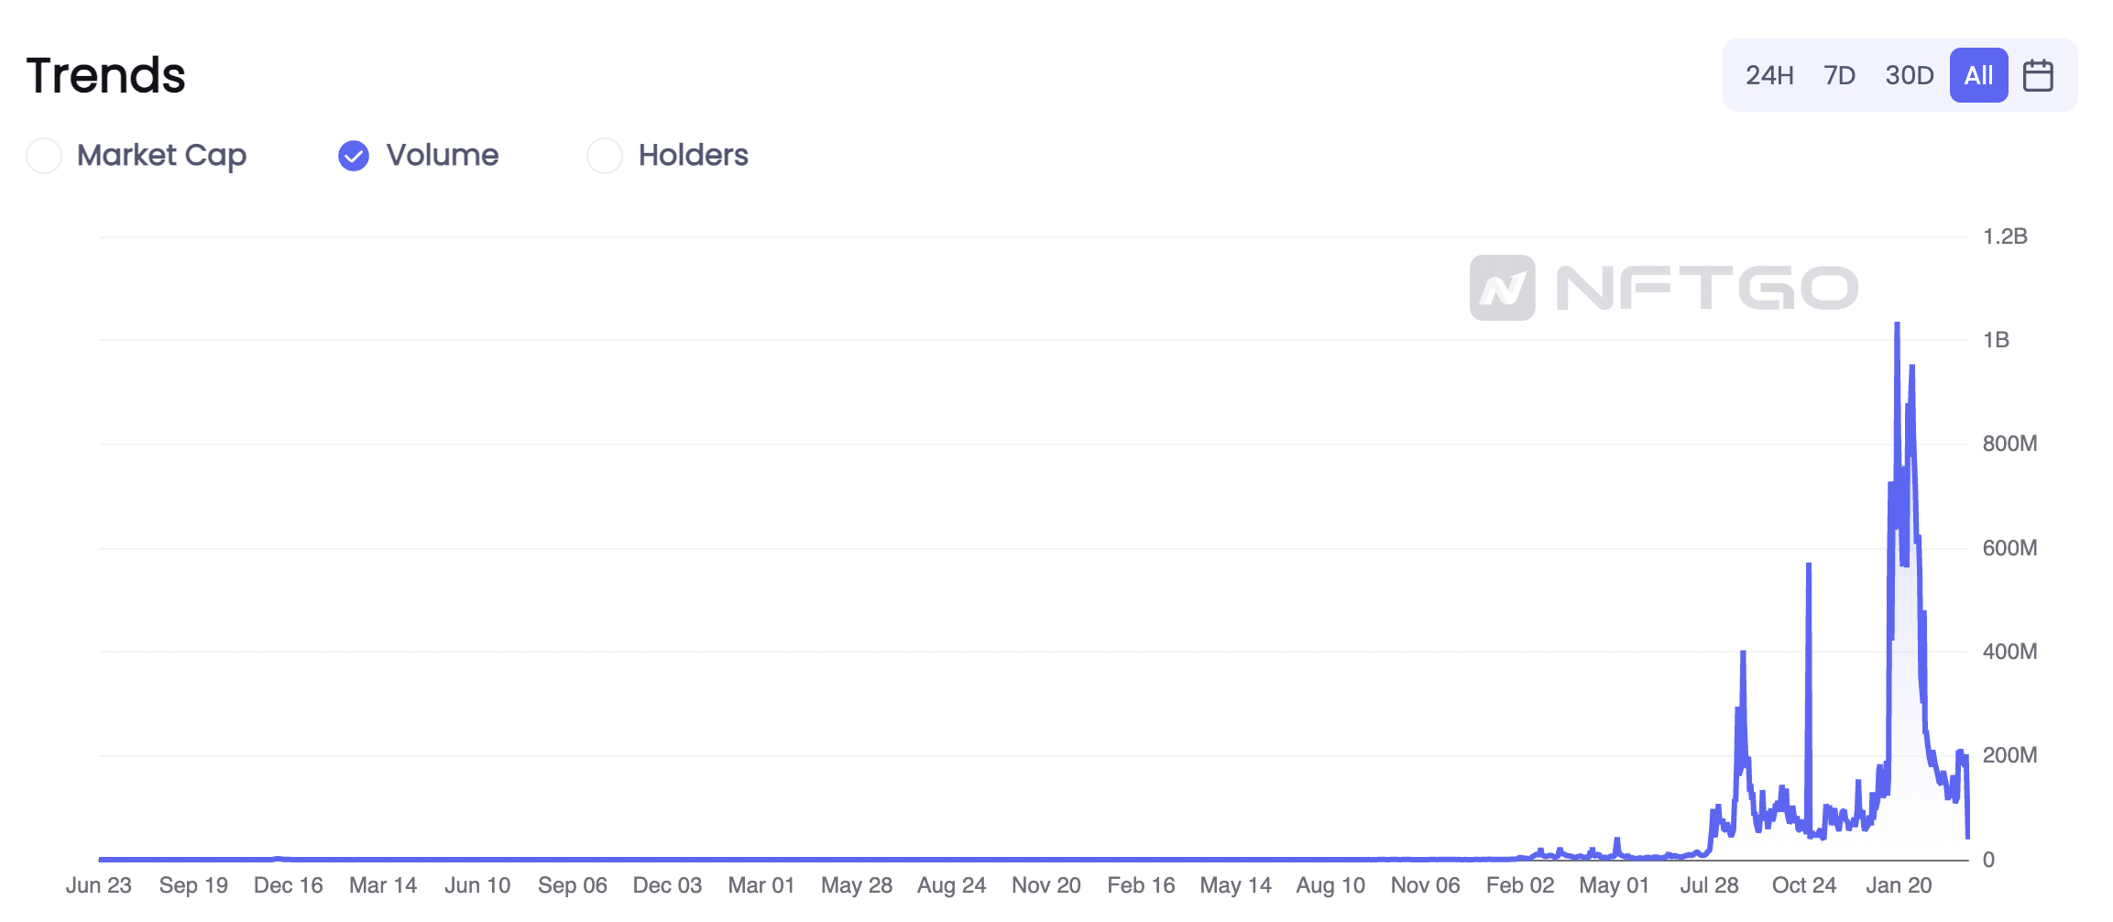
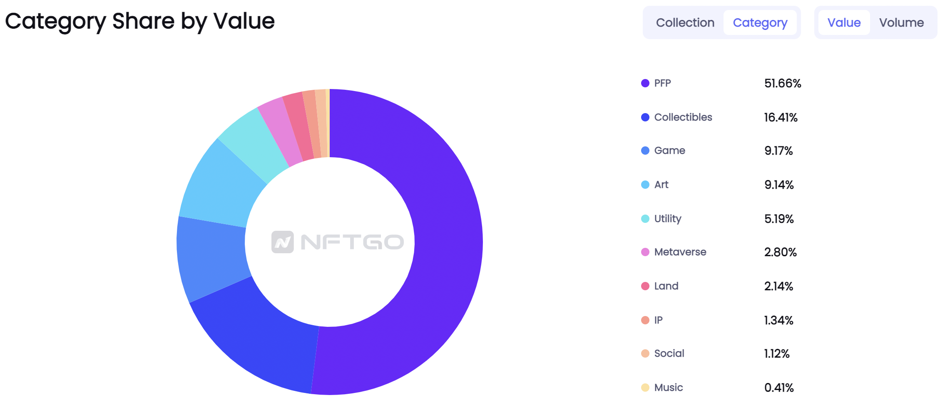
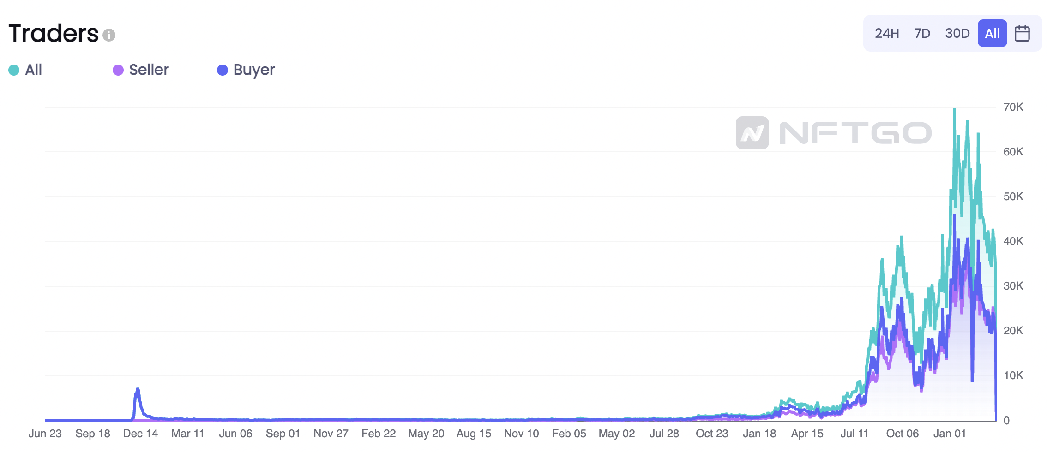
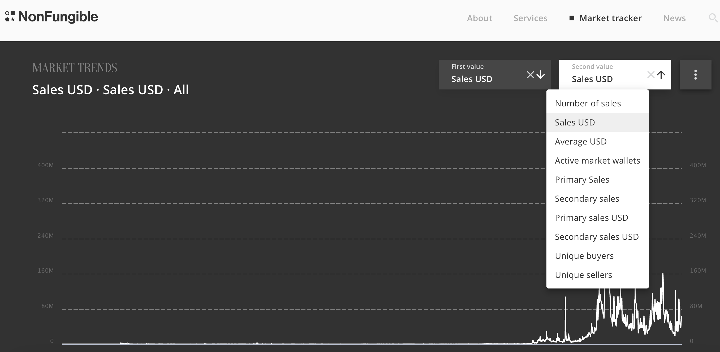
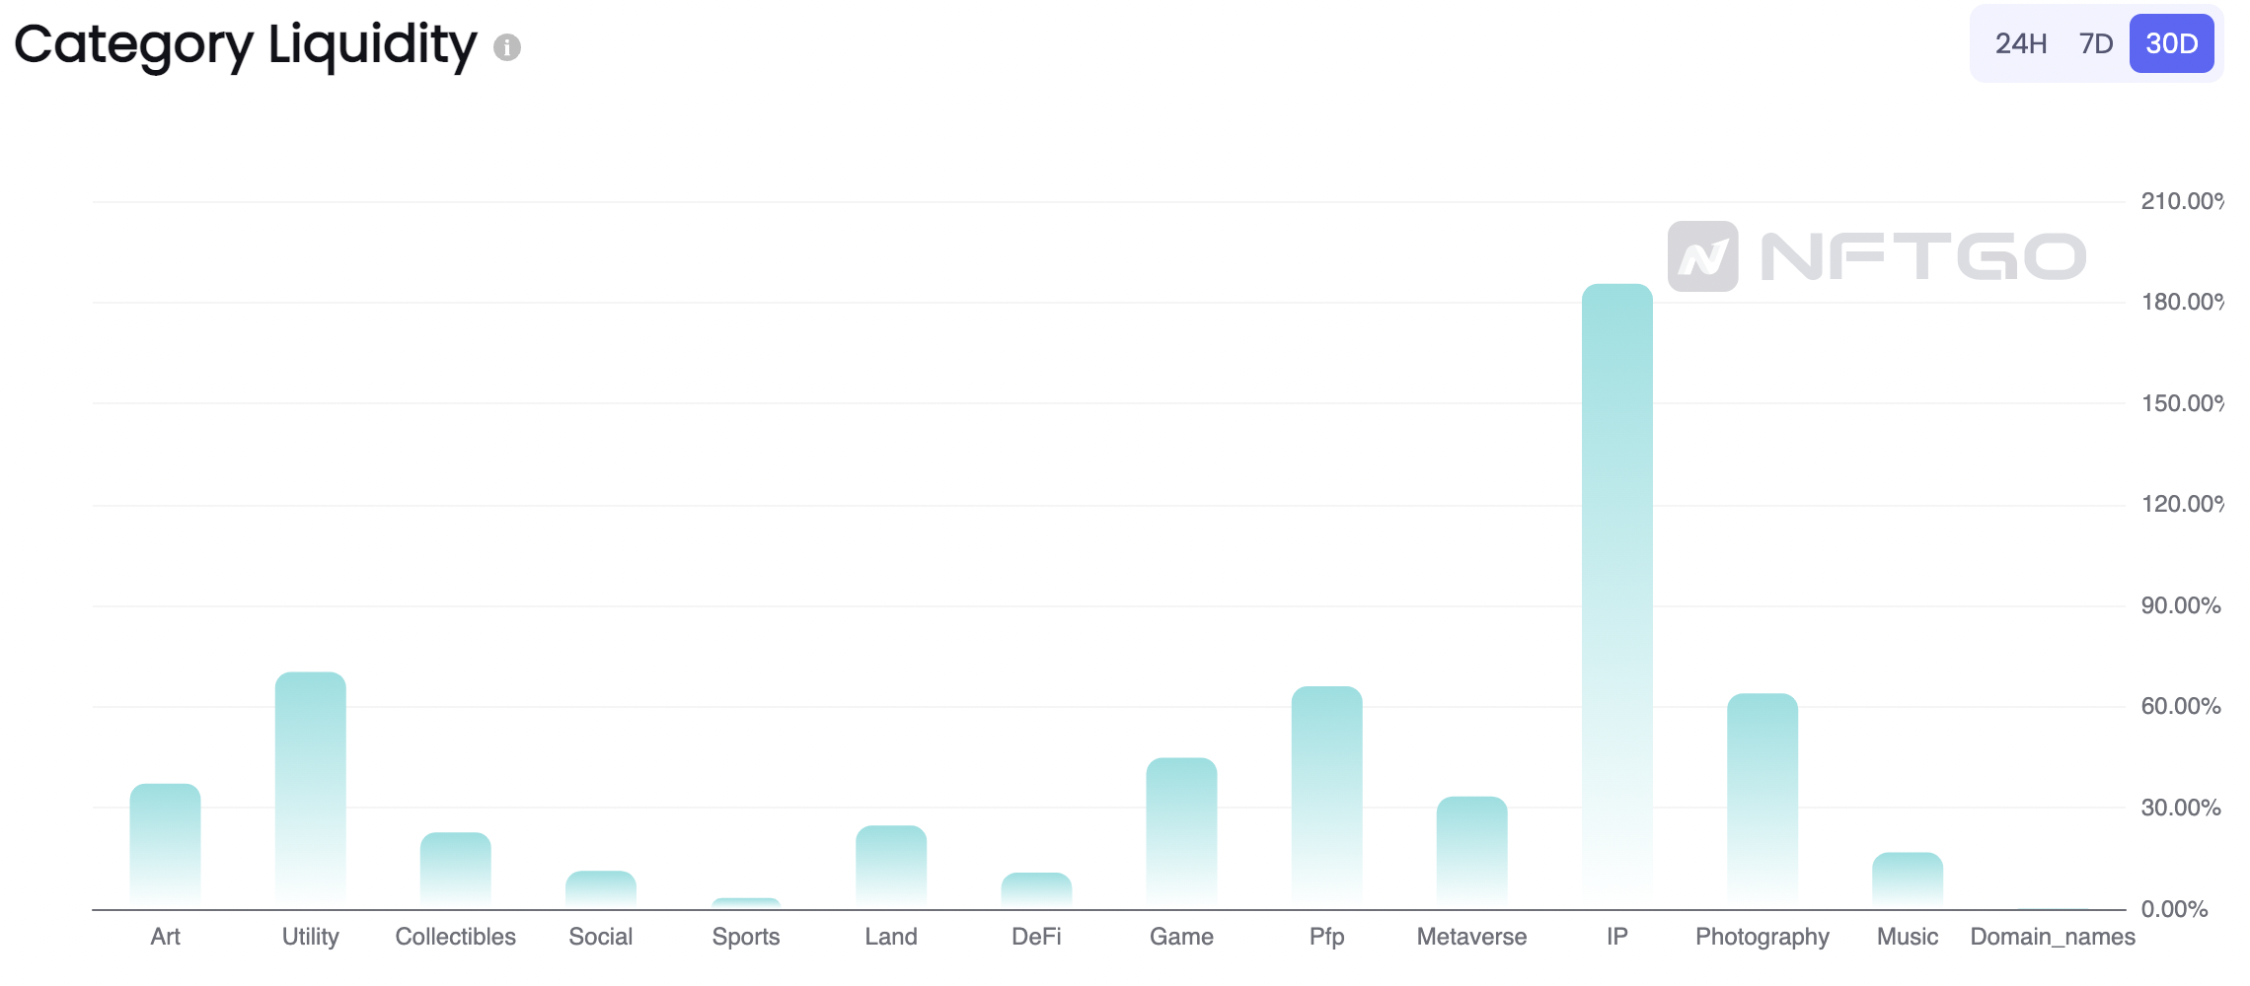

NFT Market Analysis
1
Analyze the main market performance indicators.
Understand the main drivers of NFT investment risk.
Define NFT investment risk.
$$risk=f(trend,holders,network)$$

Slide 3
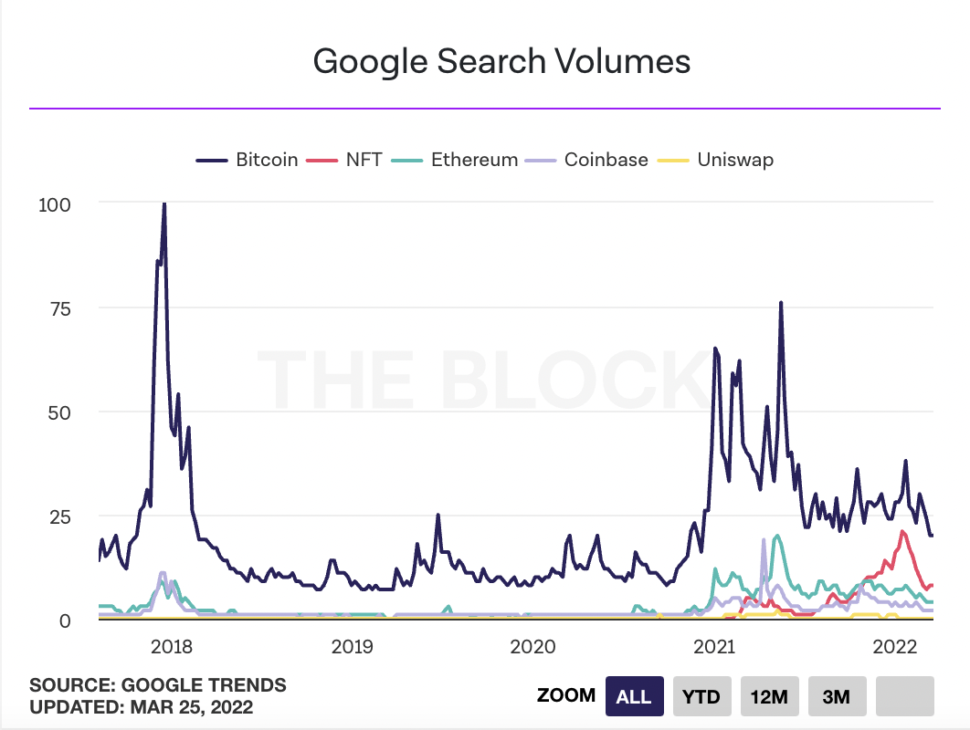
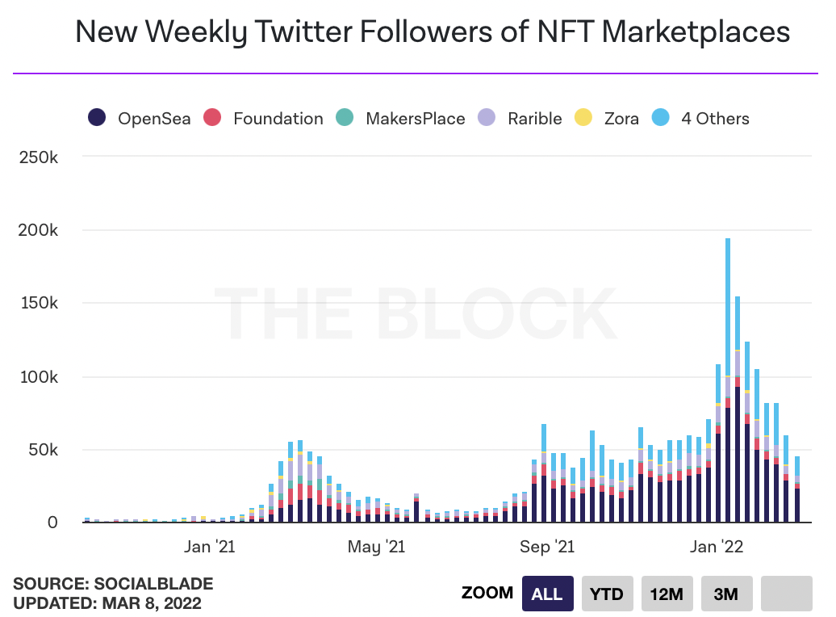
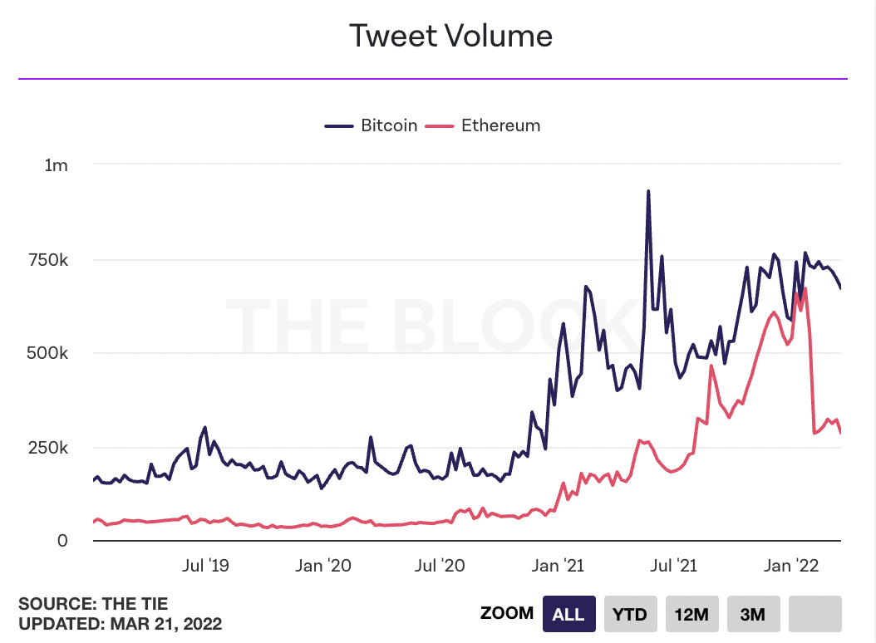
NFT Market Analysis
1
How can NFT investment risk be defined?
What are the main drivers of risk?

Slide 4
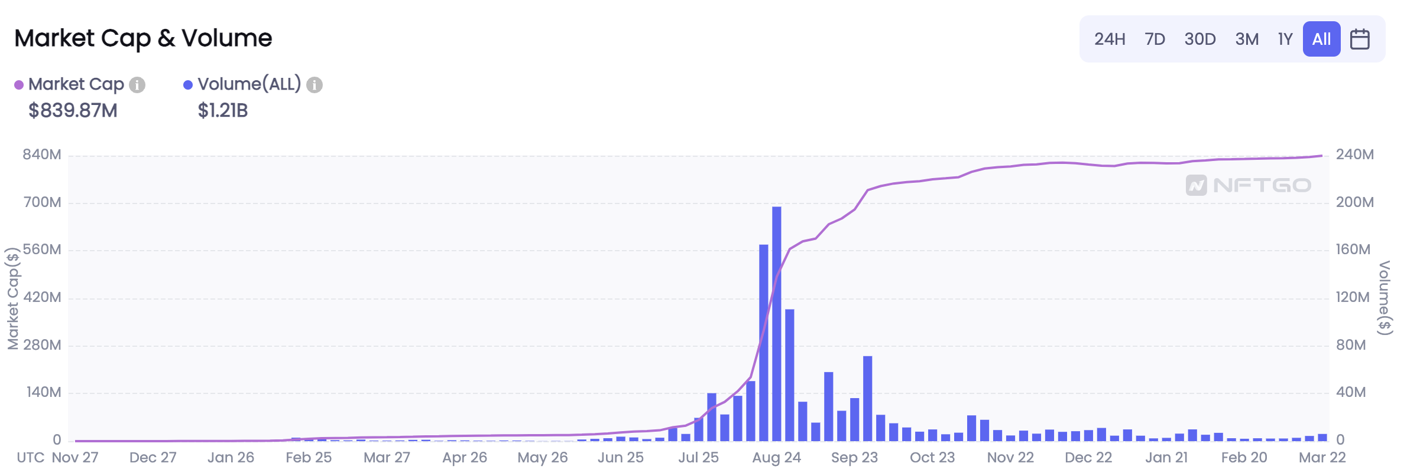
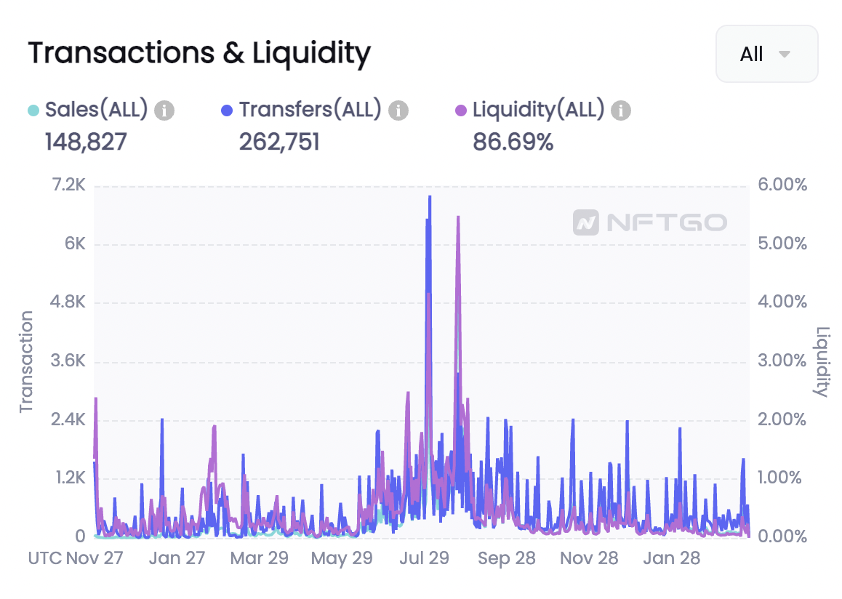
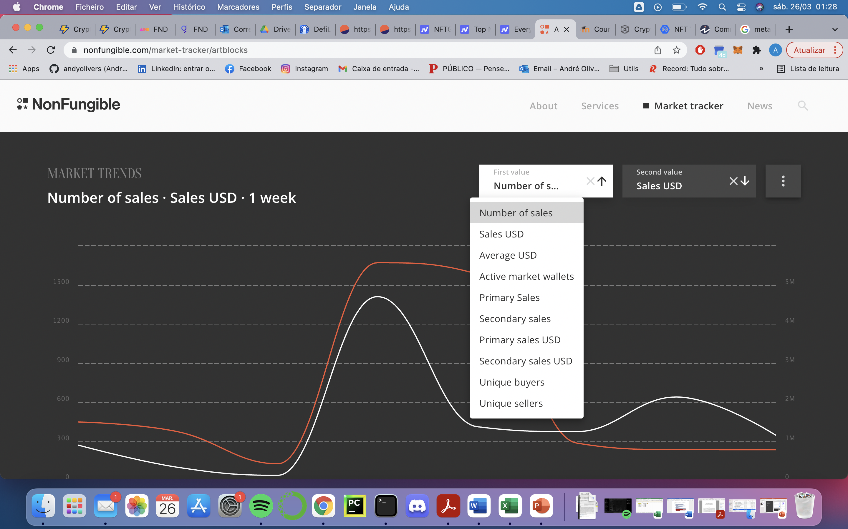
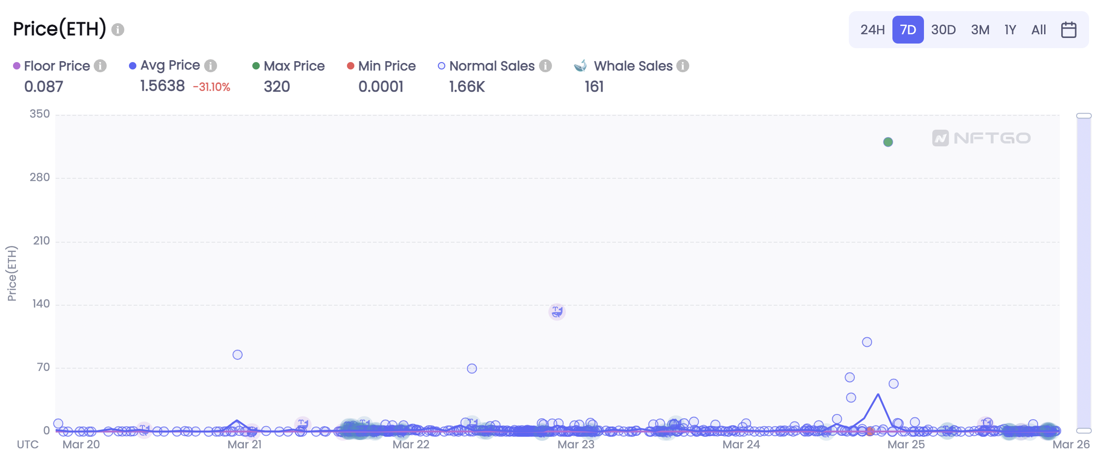
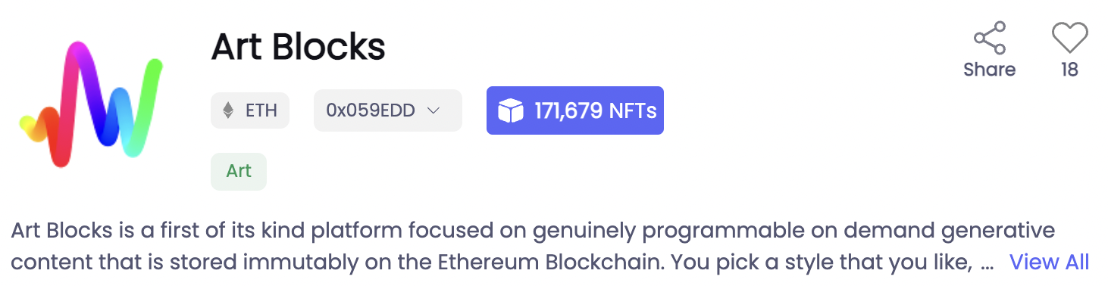
NFT Portfolio Risk Assessment
2
Analyze the main performance metrics of most popular NFT projects to define their investment risk.
Segment the different projects by investment risk.
$$portfolio risk=f(trend,holders,network)$$

Slide 5
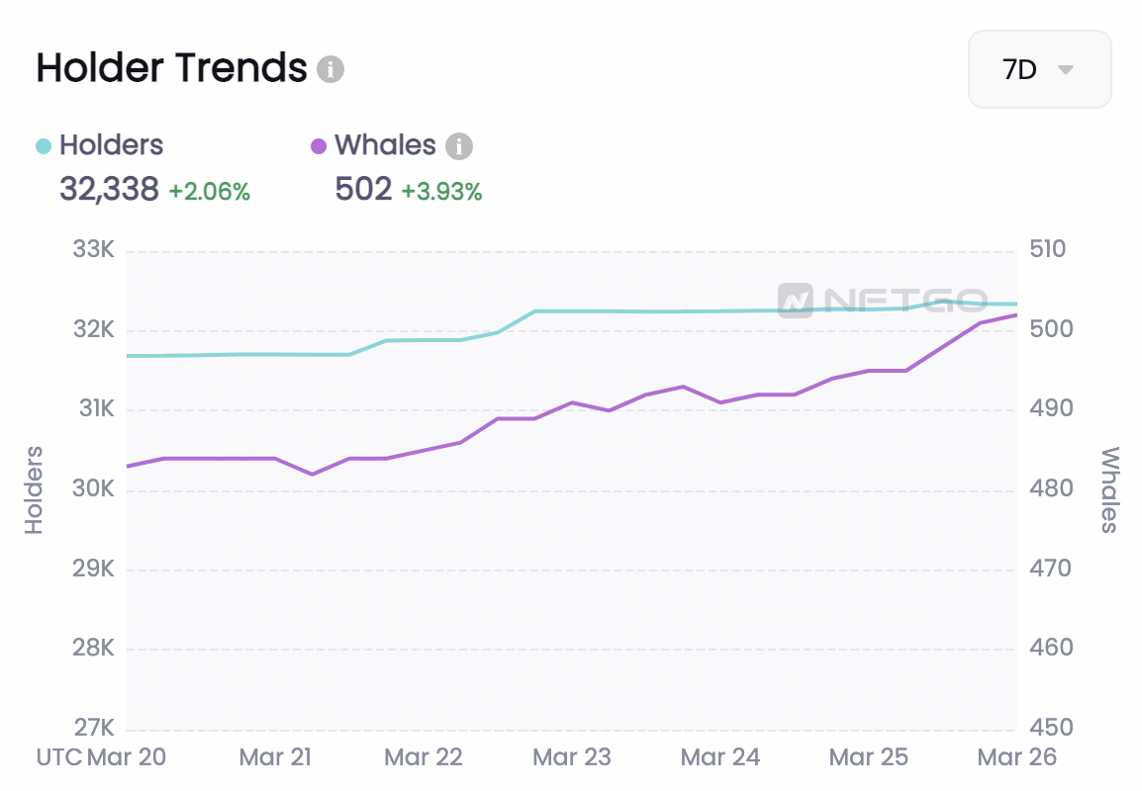
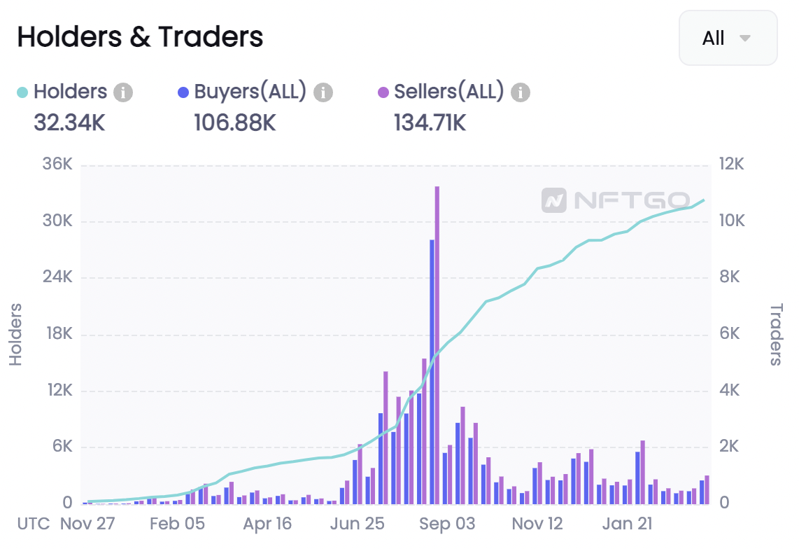
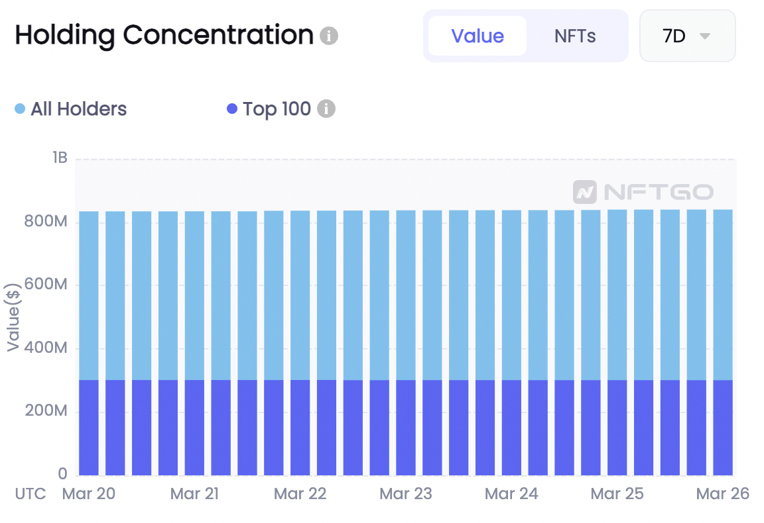
NFT Portfolio Risk Assessment
2
Is a particular portfolio a good or bad investment?
What are the main drivers of risk for a NFT portfolio?
How can risk by portfolio be quantified?

Slide 6
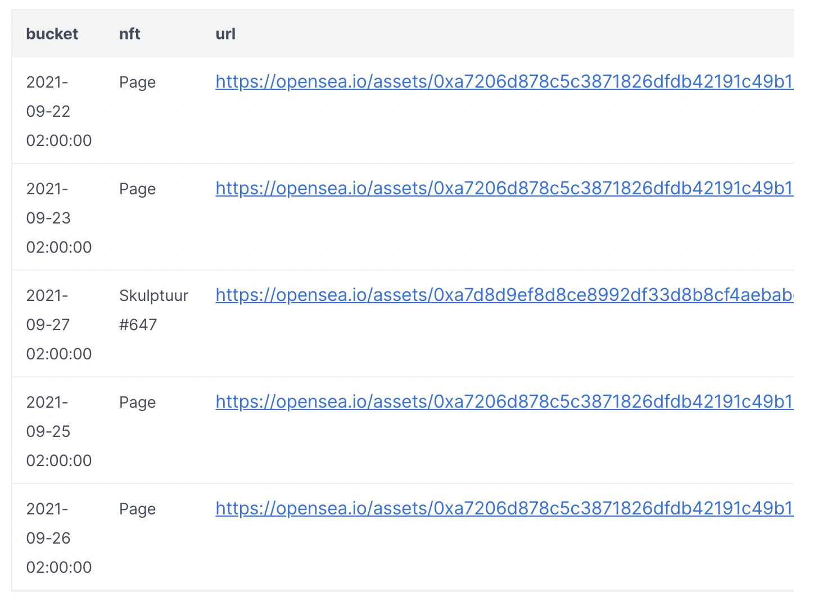
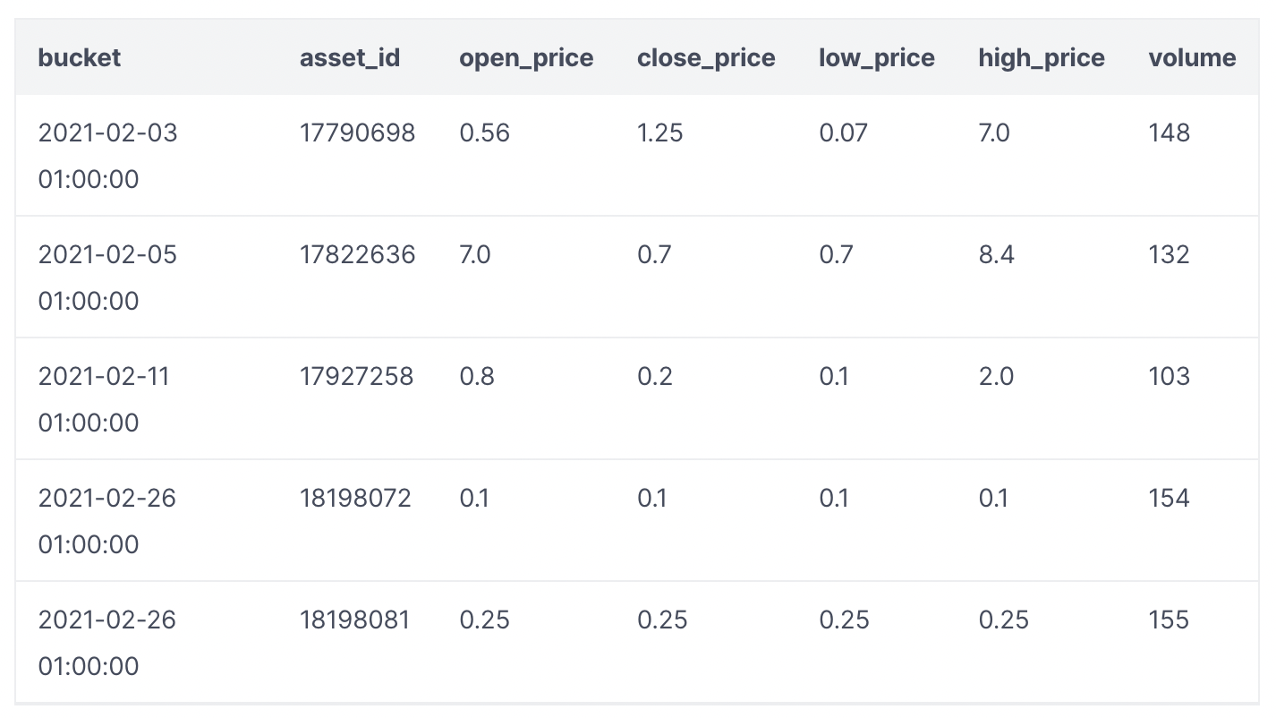
NFT Asset Risk Assessment
3
Focus on a NFT Project such as Art Blocks.
Use NFT transactional data for that Project to define assest investment risk.
Is a particular NFT asset a good or bad investment?
How can risk by asset be quantified?
$$asset risk=f(project risk, trend,holders,network)$$

